Slide 1

Optimizing Computer Sales Strategy for Competitive Advantage
Data-Driven Insights for Market Growth
Prepared by: Mukesh V
Department: Marketing / Business Analytics
Date: 04/11/1999

Slide 2

Project Overview: Unlocking Strategic Patterns
This analysis leverages statistical modeling—probability, sampling, and hypothesis testing—to uncover actionable patterns that inform better pricing, marketing, and feature strategies in the competitive computer sales landscape.
Product Features
Price Analysis
Multi-feature, CD drive, Premium class analysis.
Examining price trends and market anchors.
Sampling Reliability
Advertising & Pricing
Validating data consistency and bias via the Central Limit Theorem.
Hypothesis testing on ad impact and pricing differences.

Slide 3
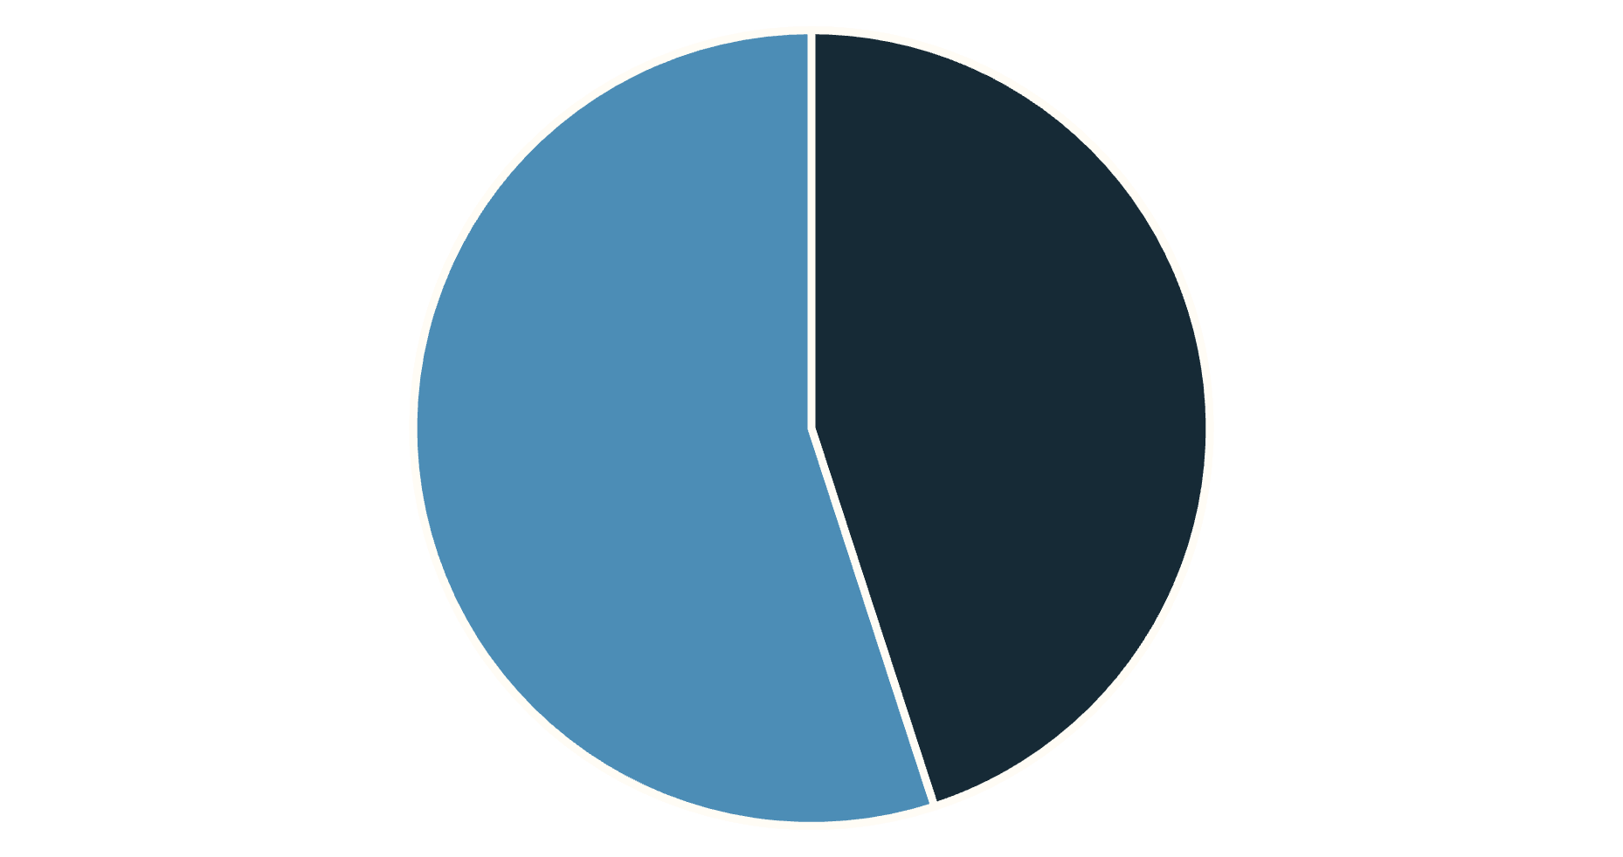

Objective 1: Product Feature Insights
We assessed the relationships between key hardware attributes (Multimedia-feature, Premium, CD drive) to identify high-value configurations and market preferences.
Key Feature Statistics
45% of all systems are Multimedia-feature enabled.
Multimedia-feature systems are 38% of the Premium class, but only 7% of Non-Premium.
Multimedia-feature is strongly correlated with Premium class (approximately 6 times higher adoption).
Only 14% of Multimedia-feature systems include a CD drive, confirming the trend toward modern, compact multi-function builds.
Multi-feature
Non-Multi
Recommendation: Introduce Multimedia-feature capabilities into the mid-tier to attract value-focused customers.
Chart Caption: Feature adoption across all systems.

Slide 4
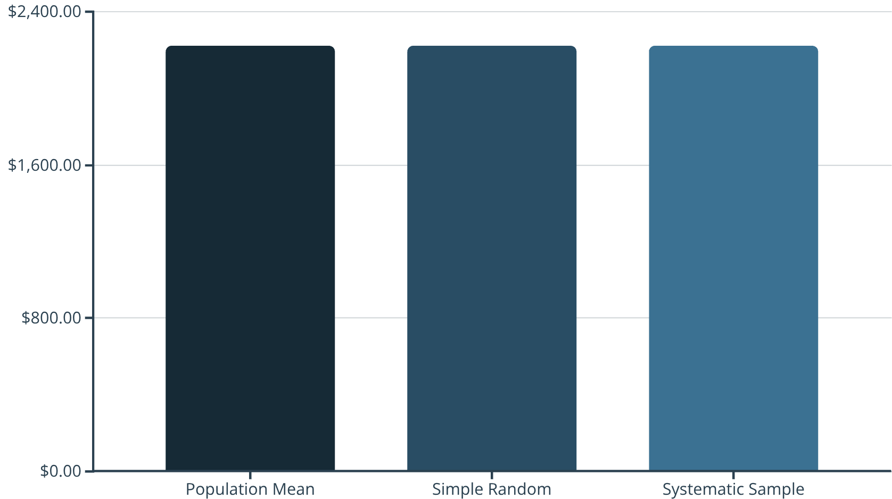
Objective 2: Sampling Accuracy in Price Analysis
To ensure our analysis is reliable, we compared different sampling techniques against the population mean price. Both random and systematic sampling methods proved highly accurate.
Minimal Bias
Both Simple Random and Systematic samples yield mean prices highly consistent with the true population mean.
Data Integrity
Chart Caption: Sampling methods produce nearly identical average prices, indicating minimal bias.
The dataset exhibits low variance, which increases confidence in price forecasting and statistical testing.

Slide 5
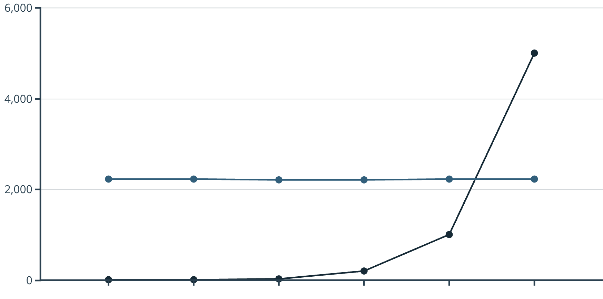

Objective 3: Price Trend and Central Limit Theorem (CLT)
The Central Limit Theorem demonstrates that as sample sizes increase, sample means converge reliably toward the true population mean. This validates our statistical approach for large-scale market analysis.
Sample Size
Sample Mean (USD)
Chart Caption: Sample means converge toward the population mean ($2219.6) as sample size increases.
As sample size (n) increases, the distribution of sample means tightens, resulting in a smaller spread and a more distinct normal shape centered around the true population mean.

Slide 6
Objective 4: Hypothesis Testing on Advertising and Price
Hypothesis tests reveal that overall market price remains stable around a $2200 anchor, and there was no significant increase in advertising spend in 2023.
Test
Metric
Statistic
p-Value
Conclusion
Z-Test (Ads)
Ads 2023 vs 2022
Z = 0.0761
0.4697
No significant ad increase in 2023.
t-Test (Price)
Price vs $2200
t = 0.098
0.923
Average market price ≈ $2200 anchor.
2-Sample t-Test
Premium vs Non-Premium Price
t = −6.404
< 0.001
Prices are significantly different.
Premium Systems are Lower Priced
Counter-intuitively, Premium systems average $2204.15, while Non-Premium systems average $2361.93. This suggests that "Premium" is defined by value and feature configuration rather than maximum cost.

Slide 7


Price Validation and CD Drive Relevance
We confirmed the market's price stability around the $2200 benchmark, highlighting that the presence of a CD drive no longer confers any price advantage.
CD Drive Obsolescence
Statistical analysis shows that the inclusion of a CD drive does not correlate with an increased selling price or perceived value.
$2214.28
Strategic Shift
Focus must shift entirely to promoting modern Multimedia-feature systems that offer integrated performance and functionality.
Average Selling Price
The average price point remains tightly aligned with the market's psychological anchor of $2200.

Slide 8
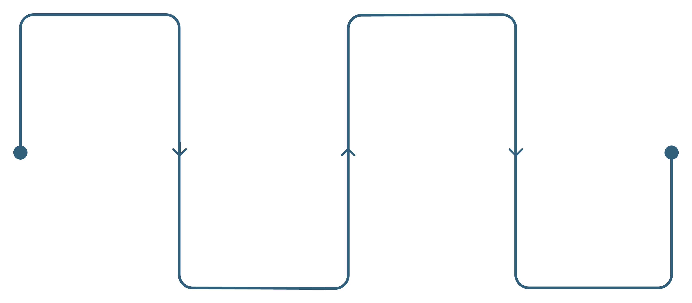


Objective 6: Confirming Statistical Reliability
A final check of statistical results and the theoretical distribution of sample means reaffirms the stability and robustness of the underlying data for future forecasting and modeling.
Sampling
Normal Fit
Collect repeated samples
Superimpose normal curve (μ≈2219)
Histogram
Consistency
Plot sample means distribution
Confirm stability across samples
Data Stability Confirmed
The dataset is exceptionally stable and follows predicted normal distribution patterns, making it highly reliable for statistical inference and advanced forecasting models.

Slide 9
Key Takeaways: Data-Driven Market Summary
Product Differentiator
45% of systems feature multi-functionality, making it the primary product differentiator in the market.
Feature-Driven Positioning
"Premium" is defined by strong feature sets and value, as Premium systems are priced lower than the Non-Premium average.
Price Stability
The market price remains stable and anchored around the psychological benchmark of $2200.
Reliable Analytics
Sampling methods and the Central Limit Theorem validate the high reliability of the underlying data for all future analysis.
Ad Efficiency Focus
Ad spend is steady, meaning marketing efforts must focus on optimizing targeting and conversion efficiency rather than increasing volume.

Slide 10
Business Recommendations: From Data to Decision
These actionable strategies are derived directly from the statistical insights, designed to build a competitive advantage in the computer sales market.
Product Strategy
1
Expand Multi-feature models across all product tiers for market reach.
Systematically phase out and drop focus on legacy CD drive inclusions.
Pricing Strategy
2
Maintain $2200 as the psychological anchor for standard systems.
Position premium systems as value-for-performance, leveraging feature advantage over sheer cost.
Marketing Strategy
3
Highlight Multi-feature benefits and system versatility in campaigns.
Prioritize ad efficiency and targeted reach over overall budget increase.
Analytics & Operations
4
Use Simple Random or Systematic Sampling for fast, reliable data audits.
Sample size n ≥ 30 is adequate for statistical analysis; large samples (n > 1000) offer minimal additional benefit.

